Slide 1
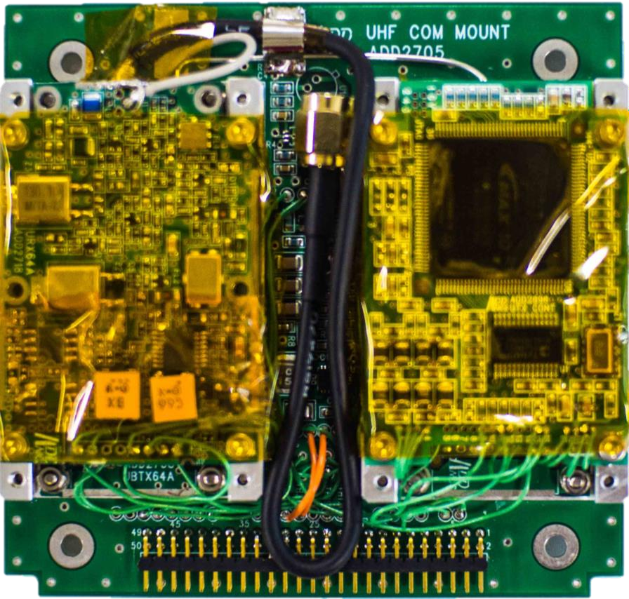
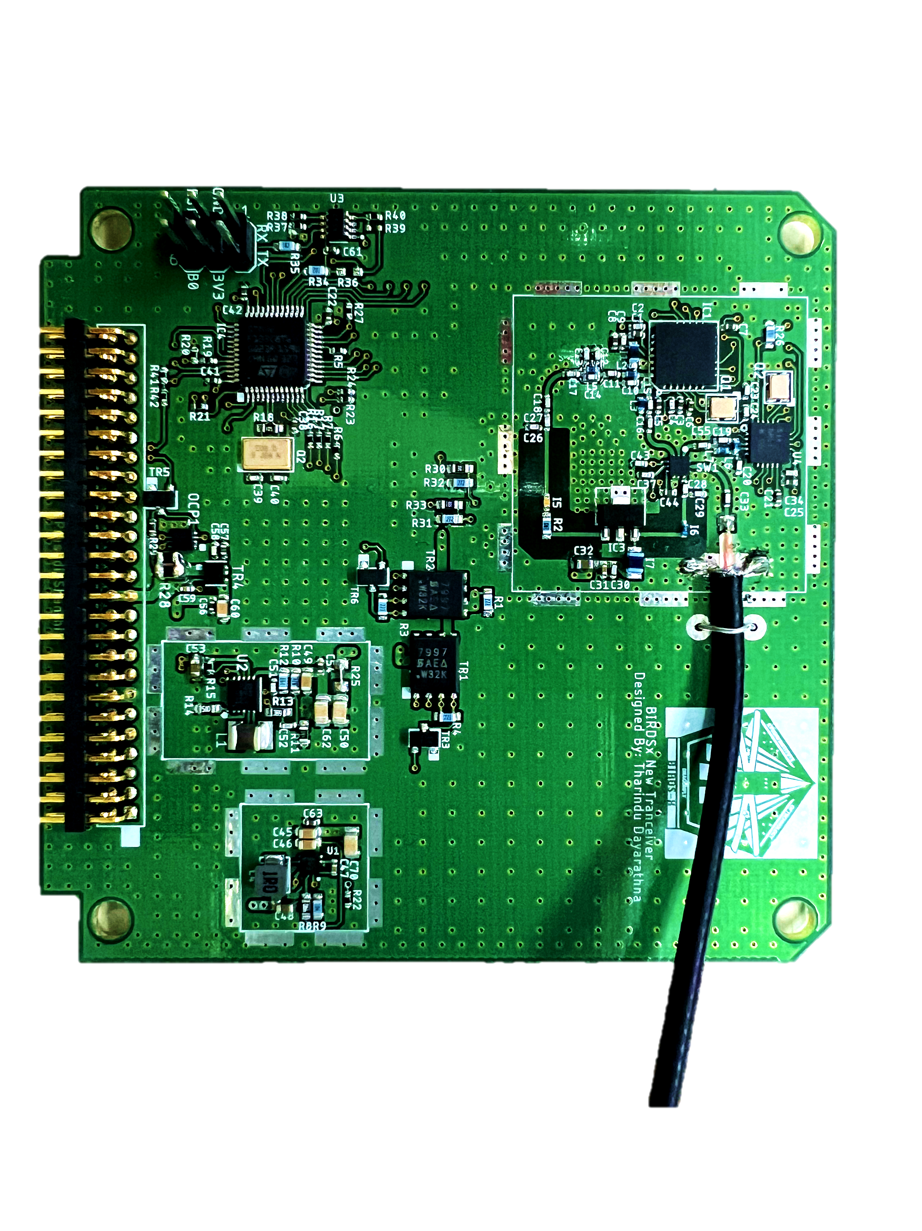
UHF Communication Subsystem
By : Yudai Etsunaga
: Tharindu Dayarathna

Slide 2
Outline
Introduction
Block Diagram
Communication Links
Power Measurement
Anechoic Chamber Test
Long Range Test
Requirement Allocation Sheet (RAS)
Schedule

Slide 3
Objectives of COM Subsystem
Receiving Uplink commands from Ground UHF ground station
and transferring to MainPIC or ResetPIC.
Transmitting telemetry/mission to Ground station
Transmitting CW morse beacon

Slide 4
COM Block Diagram
OBC Board
BPB
COM PIC
PIC18F67J94
8
UART TX
8
UART RX
Old
UHF Transceiver
7
7
44
TXRX-EN
44
UHF
Dipole-1
Reset PIC
(PIC18F67J94)
45
CW-ON
45
UART
46
CW-KEY
46
41
UART TX
40
UART RX
DIO-0
42
ADD COM Board
43
FB
ENA
38
Main
FM
SPI
SPI
UART
MUX
FM-1
SPI
41
SPI
New
UHF Transceiver
40
UHF
Dipole-2
SPI
Main PIC
(PIC18F67J94)
42
SEL
43
FM-2
SPI
38
MUX
SPI
UART to Mboss
New COM Board

Slide 5
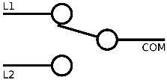
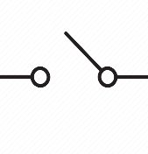
New UHF Transceiver Block Diagram
Input
Matching
network
RF-in
To antenna
3.3V
Con-1,2,3,4
3.3V
RF-out
STM32
F103C8
SPI
SX1278
Transceiver
Chip
Con-4
DIO0
Output
Matching
network
Amp Input
Matching
network
Amp Output
Matching
network
DIO1
AMP
DIO2
3.3V
UART TX
3.3V
Buck/Boost
(Low noise)
UART RX
DIO-0
Feedback
OCP
In(2.5V to 4.4V)
Con-1
5.1V
Boost
UNREG-1
EN
Con-4
Con-2

Slide 6
Photos of Two Boards
ADDNICX TRX
NEW TRX

Slide 7
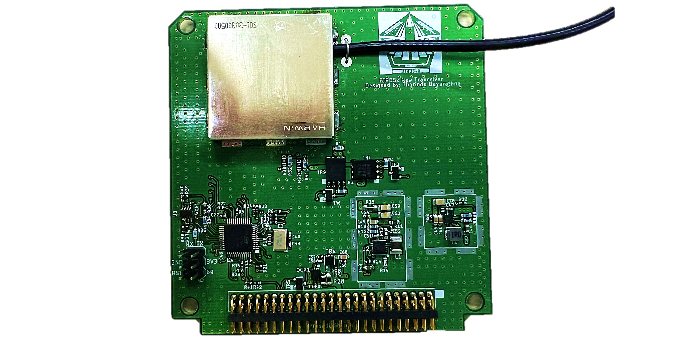
NEW UHF Board with RF shielding

Slide 8

Enabling Different Modes
UART TX
UART TX
UART RX
ADDNICS
UHF Transceiver
UART RX
New
UHF Transceiver
TXRX-EN
DIO-0
CW-ON
FB
CW-KEY
ADD COM Board
New COM Board
 | TXRX-EN | CW-ON | CW-KEY
Transmitter Mode | 1 | 0 | Not used
Receiver Mode | 0 | 0 | Not used
CW Mode | 0 | 1 | CW Key
 | DIO-0 | FB
Transmitter Mode | 1 | Feed back
Receiver Mode | 0 | Not used
CW Mode | 0 (+UART) | Not used

Slide 9
3. Communication Links
ADDNICS Transceiver | RX Mode | TX Mode | CW Mode
Frequency | 435.313 MHz | 437.375 MHz | 437.375 MHz
Bandwidth | 8.5 kHz | 8.5 kHz | 500 Hz
Modulation | GMSK | GMSK | CW Morse Code
Output Power | - | 800mW (29 dBm) | 100mW (20 dBm)
Rate | 4800 bps | 4800 bps | 20 wpm
NEW Transceiver | RX Mode | TX Mode | CW Mode
Frequency | 435.313 MHz | 437.375 MHz | 437.375 MHz
Bandwidth | 15 kHz | 15 kHz | 500 Hz
Modulation | GMSK, GFSK | GMSK, GFSK | CW Morse Code
Output Power | - | 630mW (28 dBm) | 100mW (20 dBm)
Rate | 4800 bps | 4800 bps | 20 wpm

Slide 10
Uplink Command Format
ADDNICS Tranceiver
0 | 1 | 2 | 3 | 4 | 5 | 6 | 7 | 8 | 9 | 10 | 11 | 12 | 13
0x42 | 0x77 | 0x00 | 0xAA | 0x00 | 0x00 | 0x00 | 0x00 | 0x00 | 0x00 | 0x00 | 0x00 | CRC1 | CRC2
TRX ID | SAT ID | RSV byte | CMD ID | Command Data |  |  |  |  |  |  |  | CRC bytes
NEW Tranceiver
0 | 1 | 2 | 3 | 4 | 5 | 6 | 7 | 8 | 9 | 10 | 11 | 12 | 13
0x54 | 0x77 | 0x00 | 0xAA | 0x00 | 0x00 | 0x00 | 0x00 | 0x00 | 0x00 | 0x00 | 0x00 | CRC1 | CRC2
TRX ID | SAT ID | RSV byte | CMD ID | Command Data |  |  |  |  |  |  |  | CRC bytes

Slide 11
Receiver Sensitivity
Two Sensitivity measurement tests were performed.
Anechoic chamber Test
Long Range Test ( Kyutech – Takatoyama)
Test | ADDNICS TRX Sensitivity | NEW TRX Sensitivity
Anechoic Chamber Test | -94 dBm (GMSK) | -99 dBm (GMSK) -103 dBm (GFSK, FD-5kHz)
Long Range Test (Kyutech – Takatoyama) | -103 dBm (GMSK) | -100 dBm (GMSK) -104 dBm (GFSK, FD-5kHz)
**BIRDS3 Sensitivity = -96 dBm

Slide 12
Frequency Spectrum

Slide 13
4. Power Measurement
Transmit Mode [GMSK, Output Power = 630mW (28dBm)]
 | Voltage | Current | Power | Efficiency
ADDNICS TRX
New TRX
CW Mode [Output Power = 100mW (20dBm)]
 | Voltage | Current | Power | Efficiency
ADDNICS TRX
New TRX
Receive Mode
 | Voltage | Current | Power
ADDNICS TRX
New TRX

Slide 14
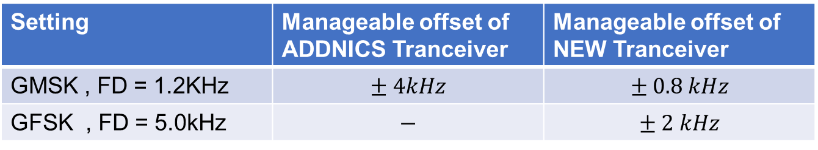
Center Frequency Offset Issue
TX Signal
Spectrum
f1
Receiver
Bandwidth
f2
Center Frequency offset = f2-f1
Setting | Manageable offset of ADDNICS Tranceiver | Manageable offset of NEW Tranceiver
GMSK , FD = 1.2KHz | $$± 4kHz$$ | $$± 0.8 kHz$$
GFSK , FD = 5.0kHz | $$−$$ | $$± 2 kHz$$

Slide 15
Ways to Overcome Center Frequency Offset Issue
Use signal Generator to send uplink commands with 5kHz frequency Deviation
Enabling receiver chip (SX1278) AFC
(Automatic frequency correction) function
Using second tranceiver chip (Si4432) mounted
in the tranceiver.
Si4432
SX1278

Slide 16
Schedule
TASK | 2023 |  |  |  |  |  |  |  |  |  |  |  |  |  |  |  |  |  |  |  |  |  |  |  |  |  |  |  |  |  |  |  |  |  |  |  |  |  |  |  |  |  |  |  |  |  |  |  |  |  |  |  | 2024
 | JAN |  |  |  |  | FEB |  |  |  | MAR |  |  |  | APR |  |  |  | MAY |  |  |  |  | JUN |  |  |  | JUL |  |  |  | AUG |  |  |  |  | SEP |  |  |  | OCT |  |  |  | NOV |  |  |  |  | DEC |  |  |  | JAN |  |  |  |  | FEB |  |  |  | MAR |  |  |  | APR
Mission Definition Review (MDR)
Secure all components
Programming of COMM
Procurement
Preliminary Design Review (PDR)
EM Functional Test, EM Integration
Long Range Test, End to End Test
Vibration Testing
Thermal Testing
After 30 mins Test
Critical Design Review (CDR)
FM Functional Test
FM Integration
Long Range Test, End to End Test, Long Duration Test
Launch Environmental Testing
Space Environmental Testing
After 30 mins Test
Fight Readiness Review
Hand-over Satellite
Selection of 10 teams
EM board arrival
Selection of 5 teams
FM board arrival

Slide 17
Question and Answer

